Slide 1

CSE-5335: Presentation
Sai Siva Deepthi Gopireddy – 1002067864
Sawini Reddy Chitti - 1002081573
Aravind Kanala - 1002129212
Sai Sumana Adurugatla - 1002073766
Keerthi Sai Bheemavarapu- 1002082866
Section: 5335-004
Fall 2023

Slide 2

Final Presentation Demo

Slide 3

TECHNOLOGIES USED

Slide 4

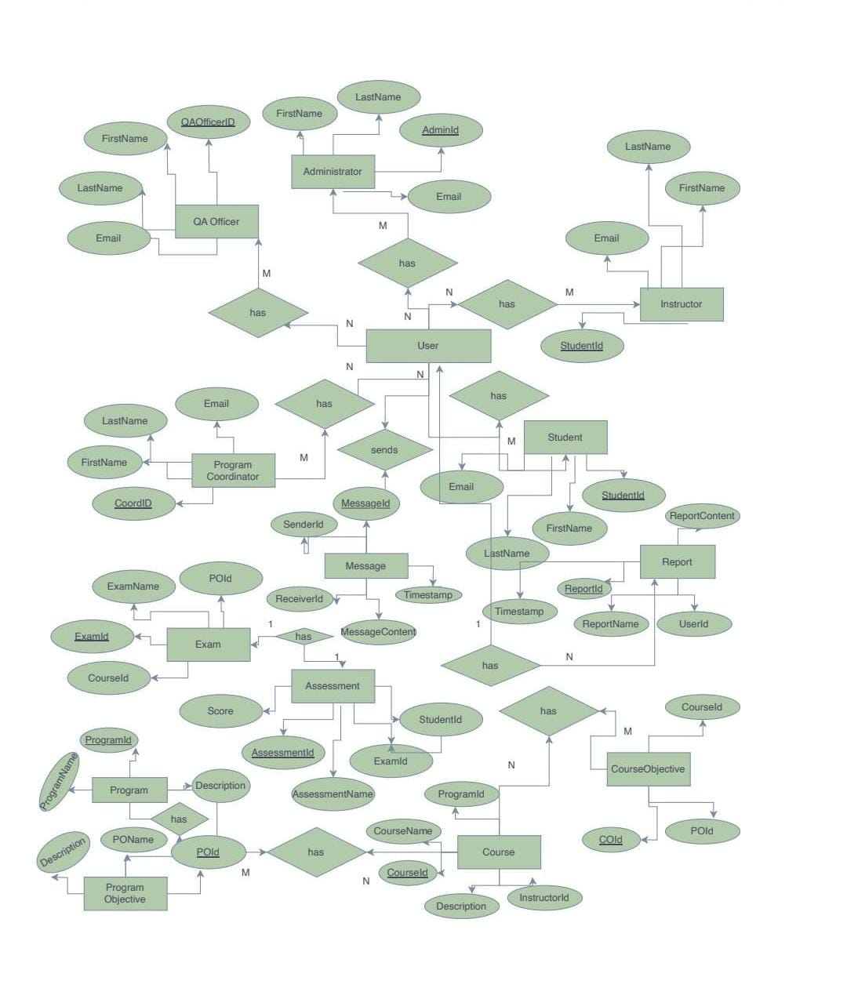
ER Diagram

Slide 5
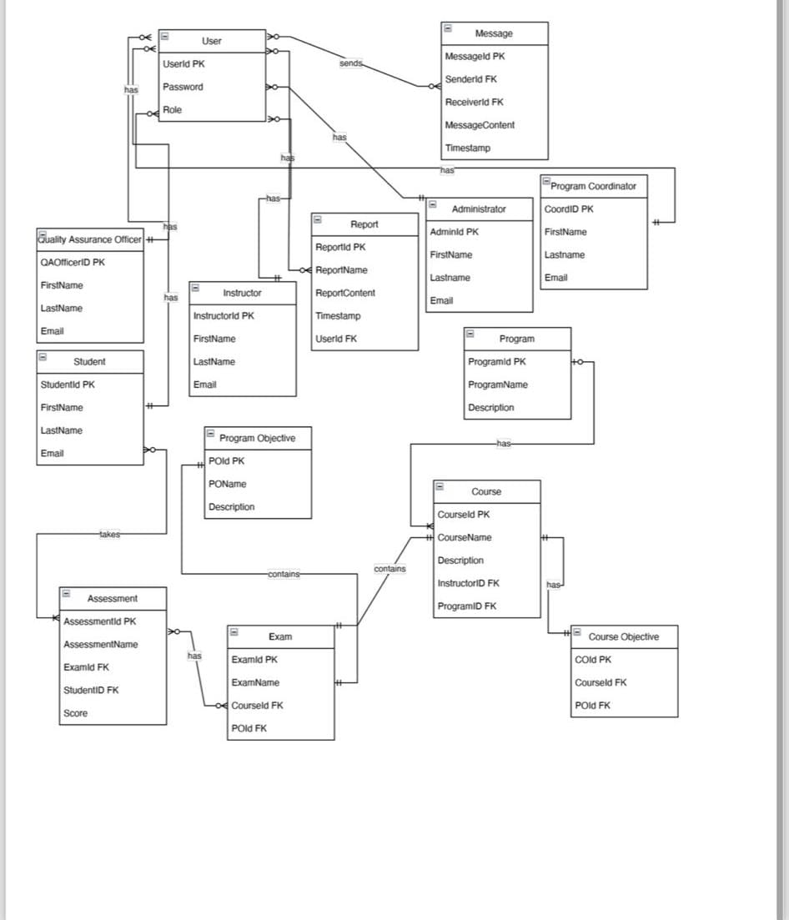
Relational Model

Slide 6
PAGES BEFORE LOGIN

Slide 7
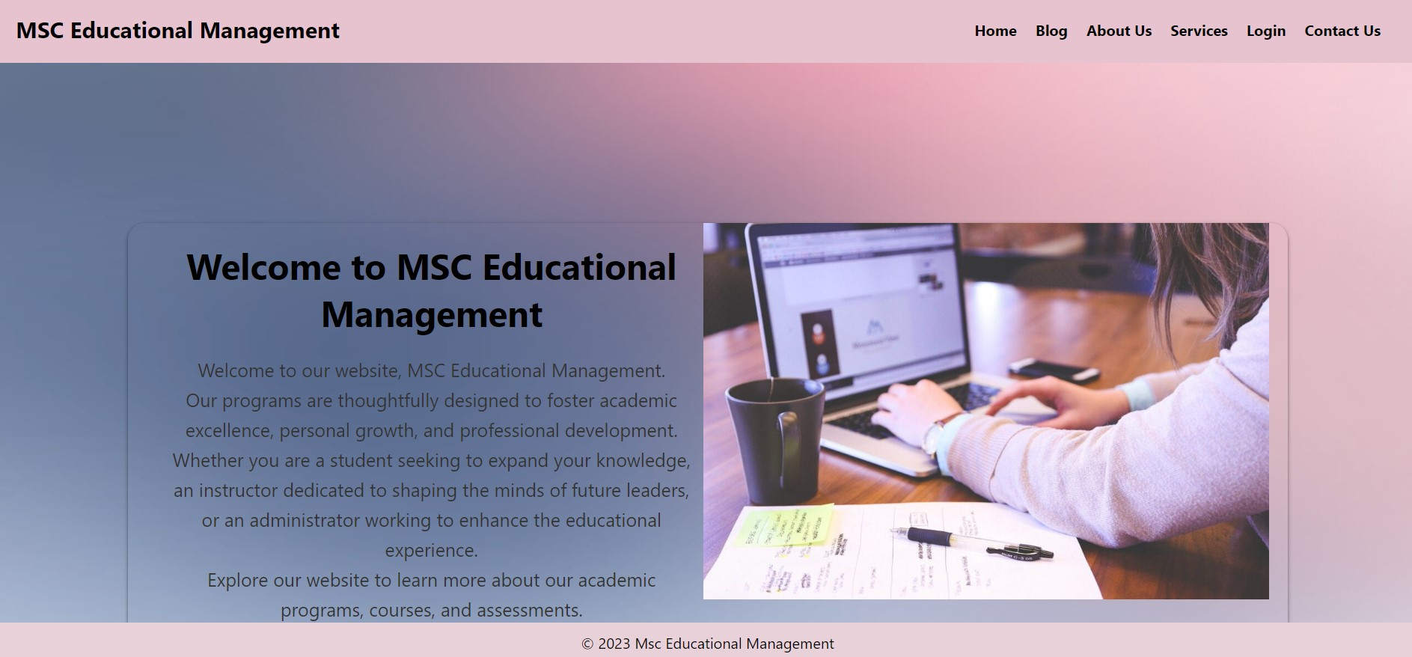
HOME PAGE
From Homepage we can navigate to
Blog
About Us
Services
Login
Contact Us

Slide 8
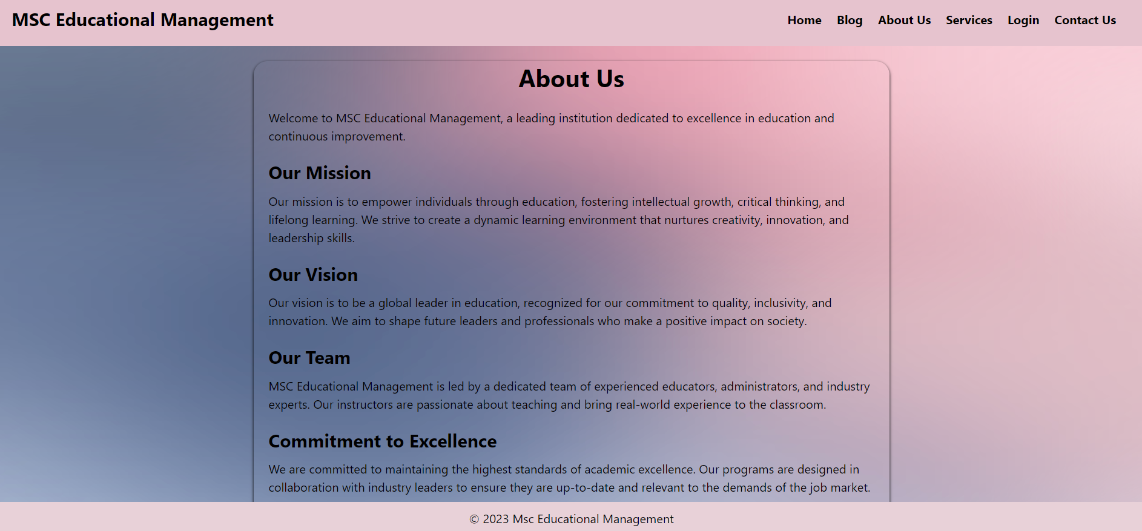
ABOUT US
In about us page we describe our mission , vision and commitment to maintain the website.
And we give a brief about our team and performance measurement.

Slide 9
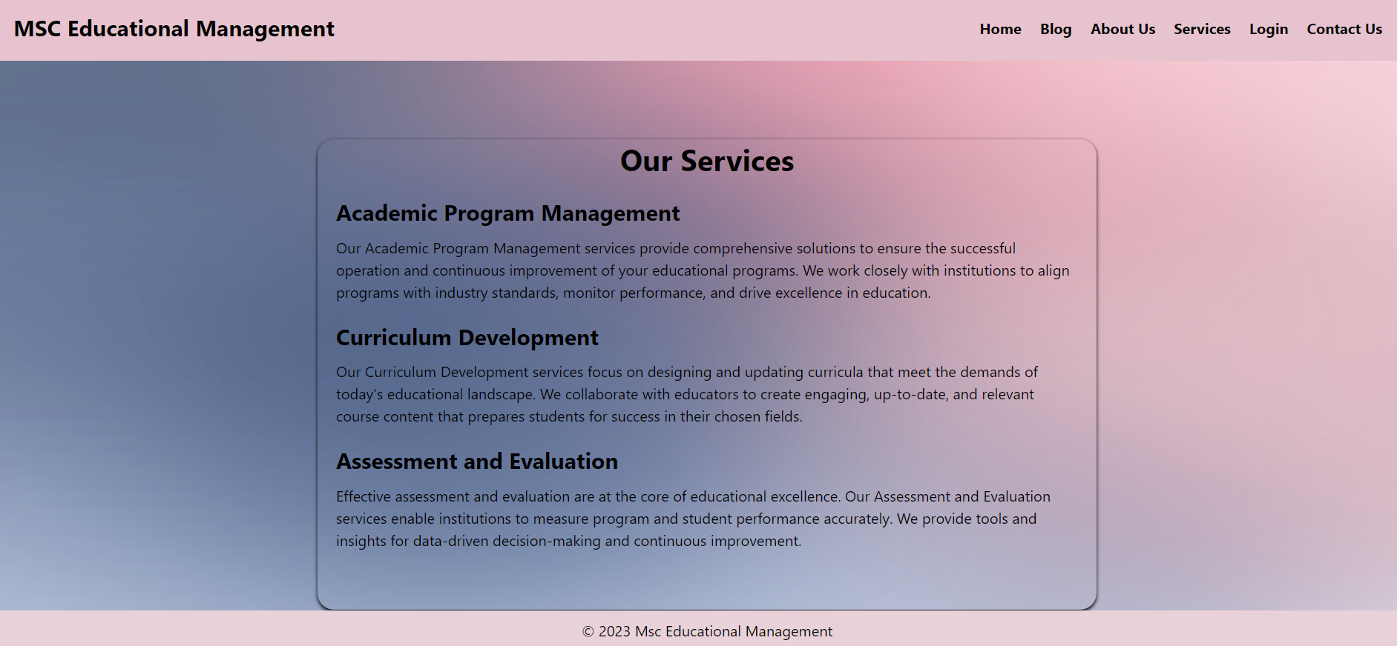
SERVICES
We give a brief about our services like:
Academic Program management
Curriculum Development
Assessment and Evaluation

Slide 10
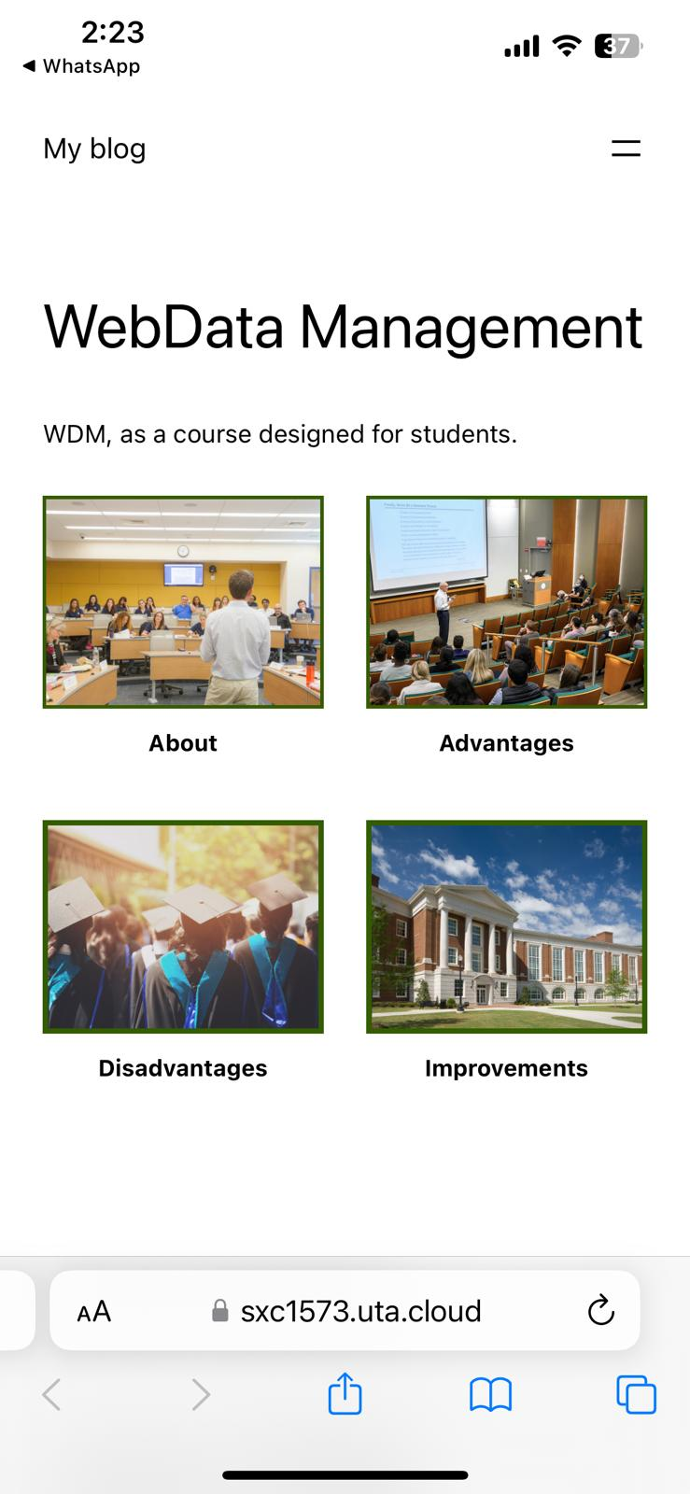
BLOG
Blog is done by using word press.
We have four posts regarding our website. They are as follows:
About
Advantages
Disadvantages
Improvements

Slide 11
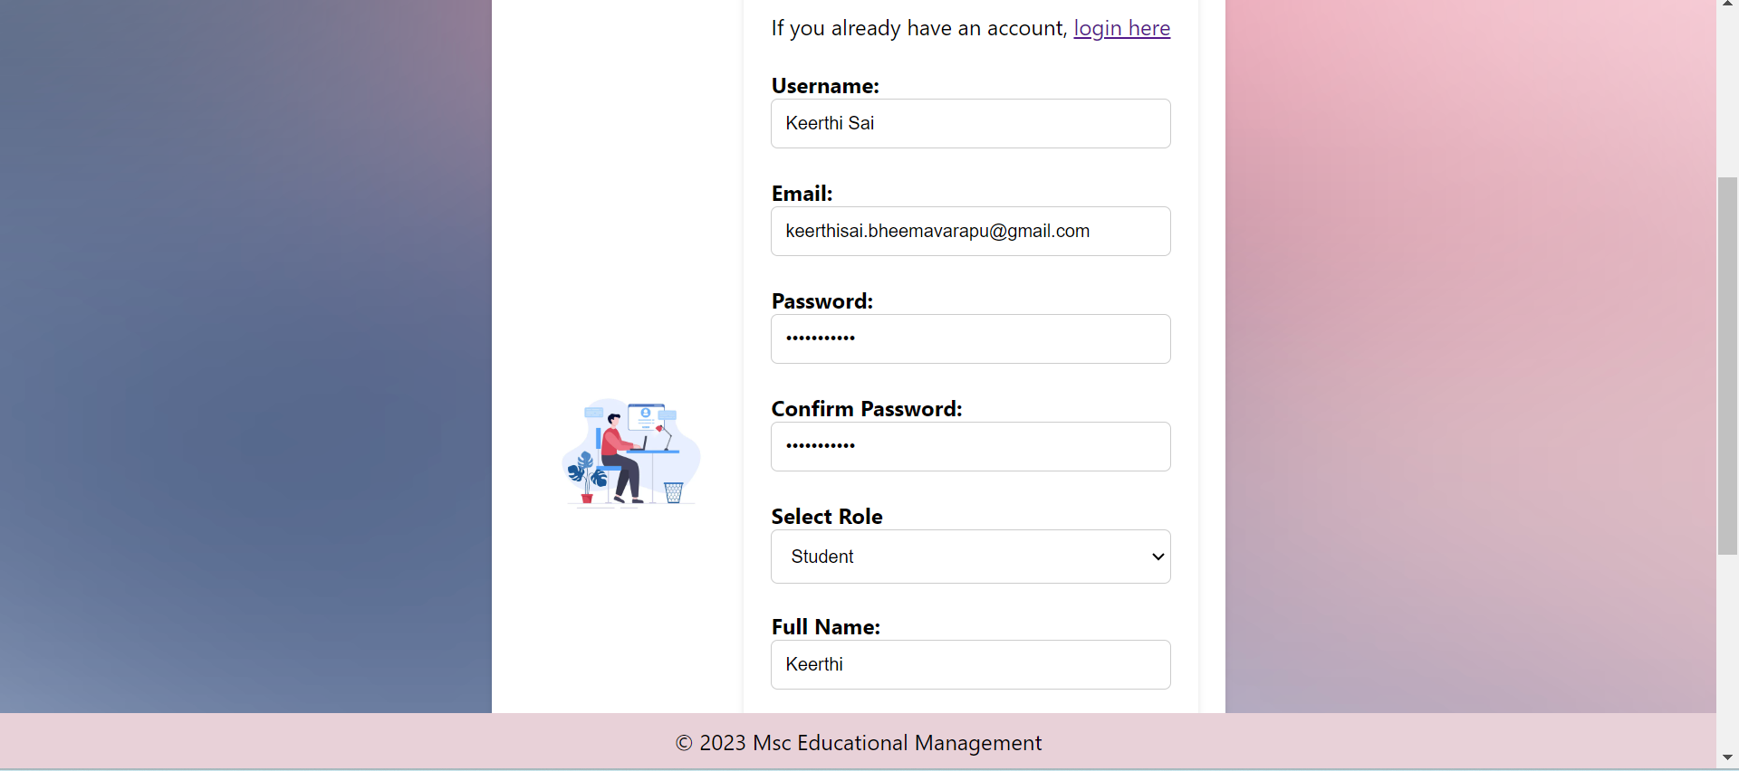

SIGN UP PAGE

Slide 12
The Signup page is where new users register to access the website.
When first time user tries to create a new account with the roles of Student, Admin, QA officer, Instructor, or Program Coordinator, we first verify if the given email address is a valid email address or not.
We do the verification by sending an OTP to the email Id provided by the user. The OTP must be then entered in the signup form to complete the verification.
This form has validations for fields such as email and password.

Slide 13



Slide 14
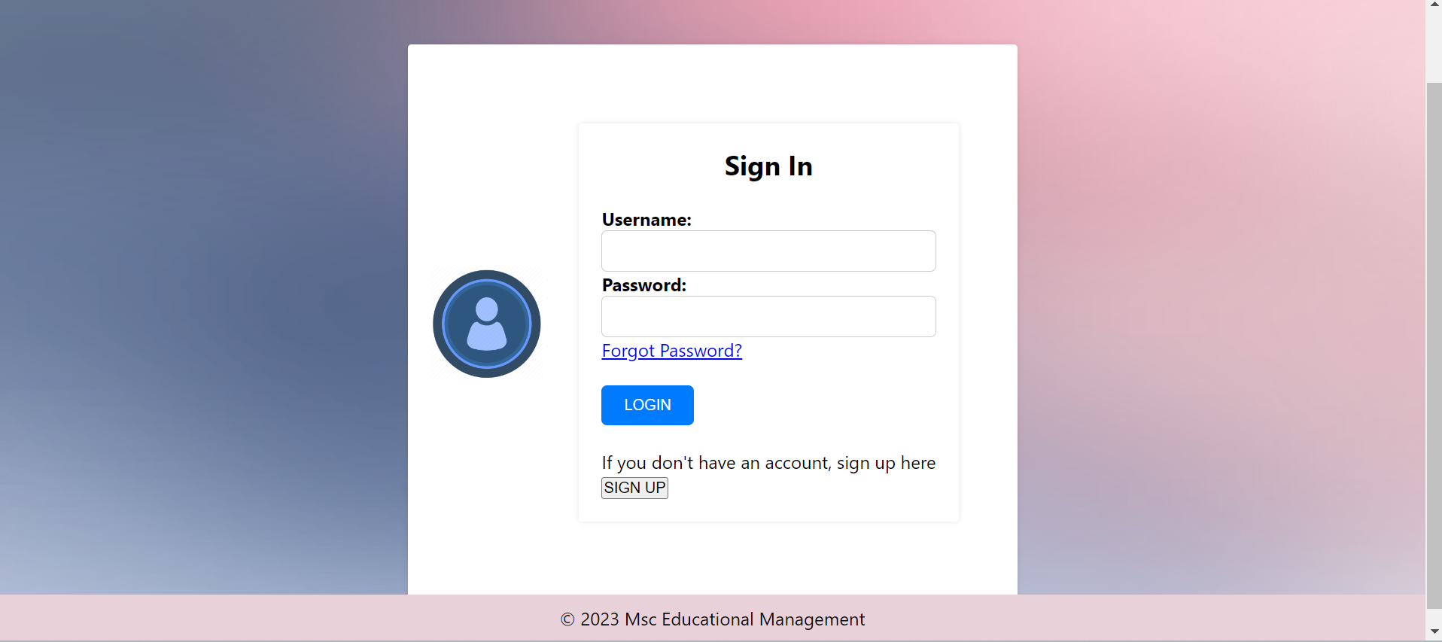
SIGN IN PAGE
The sign in page can be accessed by clicking the 'Login' button on the navbar from the home page.
Through this page, users of different roles can login with their credentials and will be redirected to their corresponding dashboards.
On this form, the user will also have access to hyperlinks to signup page and forgot password page.

Slide 15
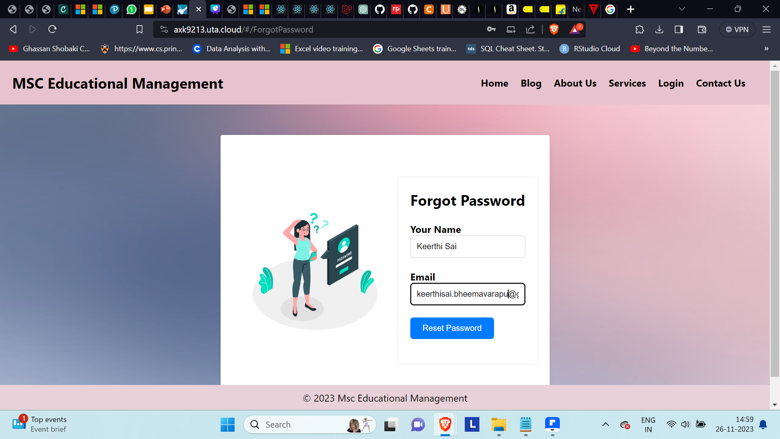
FORGOT PASSWORD
If a user wants to reset their password (user might be a student, QA officer, Instructor or Program Coordinator), then they need to provide their registered email address to receive a password reset email.
We are using Send grid as our backed email API to send emails for various use cases in the application.

Slide 16
PAGES AFTER LOGIN

Slide 17
STUDENT DASHBOARD

Slide 18
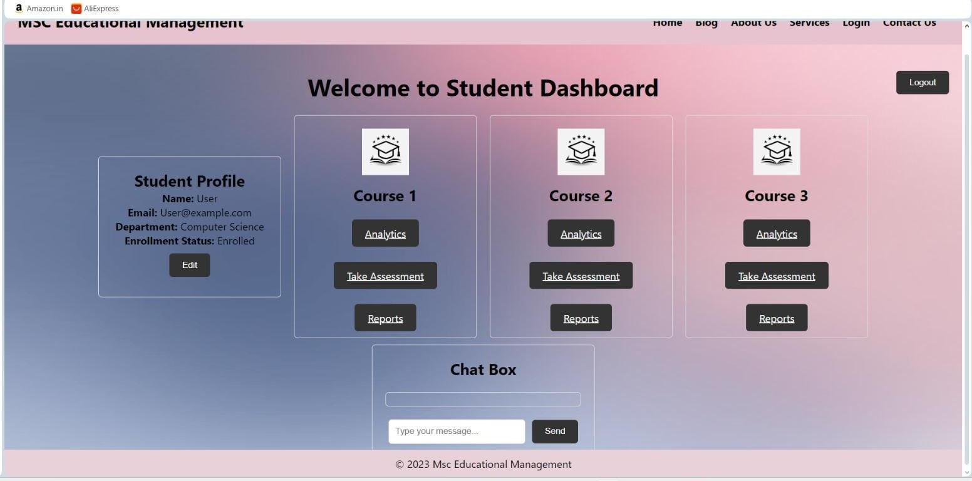
STUDENT DASHBOARD

Slide 19
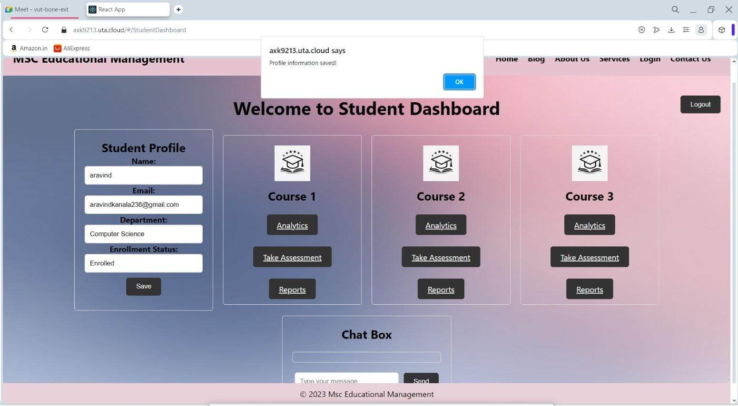
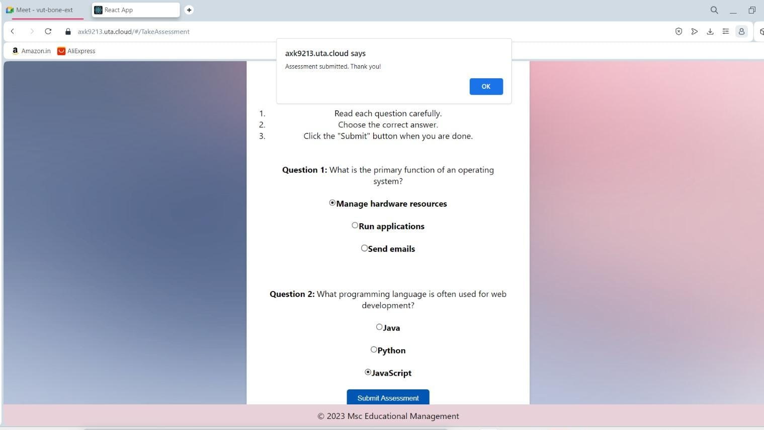
STUDENT DASHBOARD
Here, we can see that the student can edit his profile
Also, here the student can take the assessment.

Slide 20
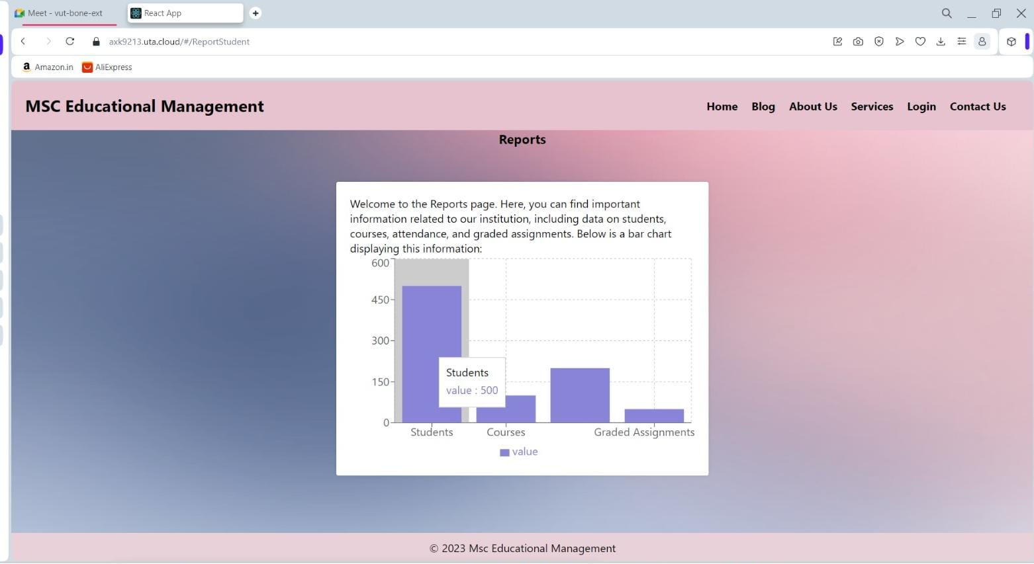
STUDENT DASHBOARD
Here, you can hover on each bar and see the results similar to this.

Slide 21
ADMIN DASHBOARD

Slide 22
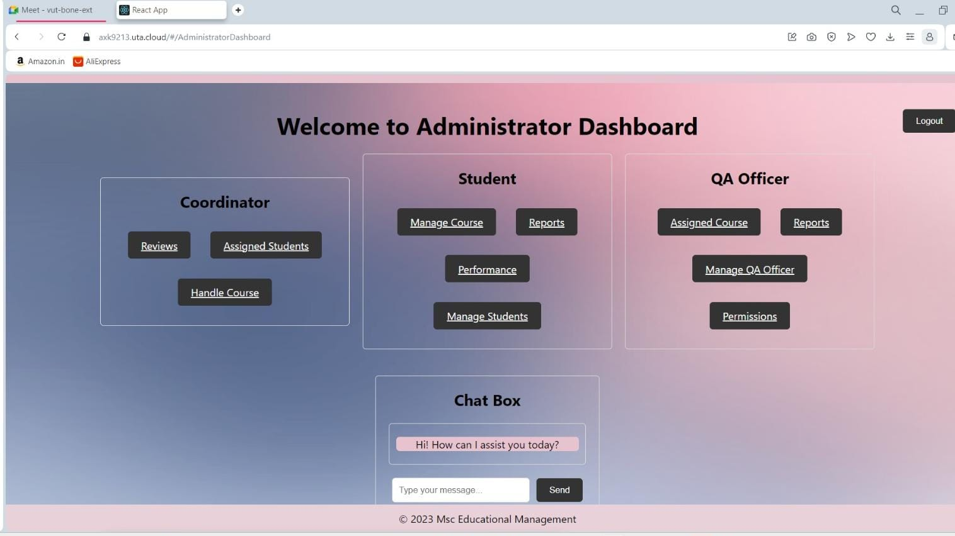
ADMIN DASHBOARD

Slide 23
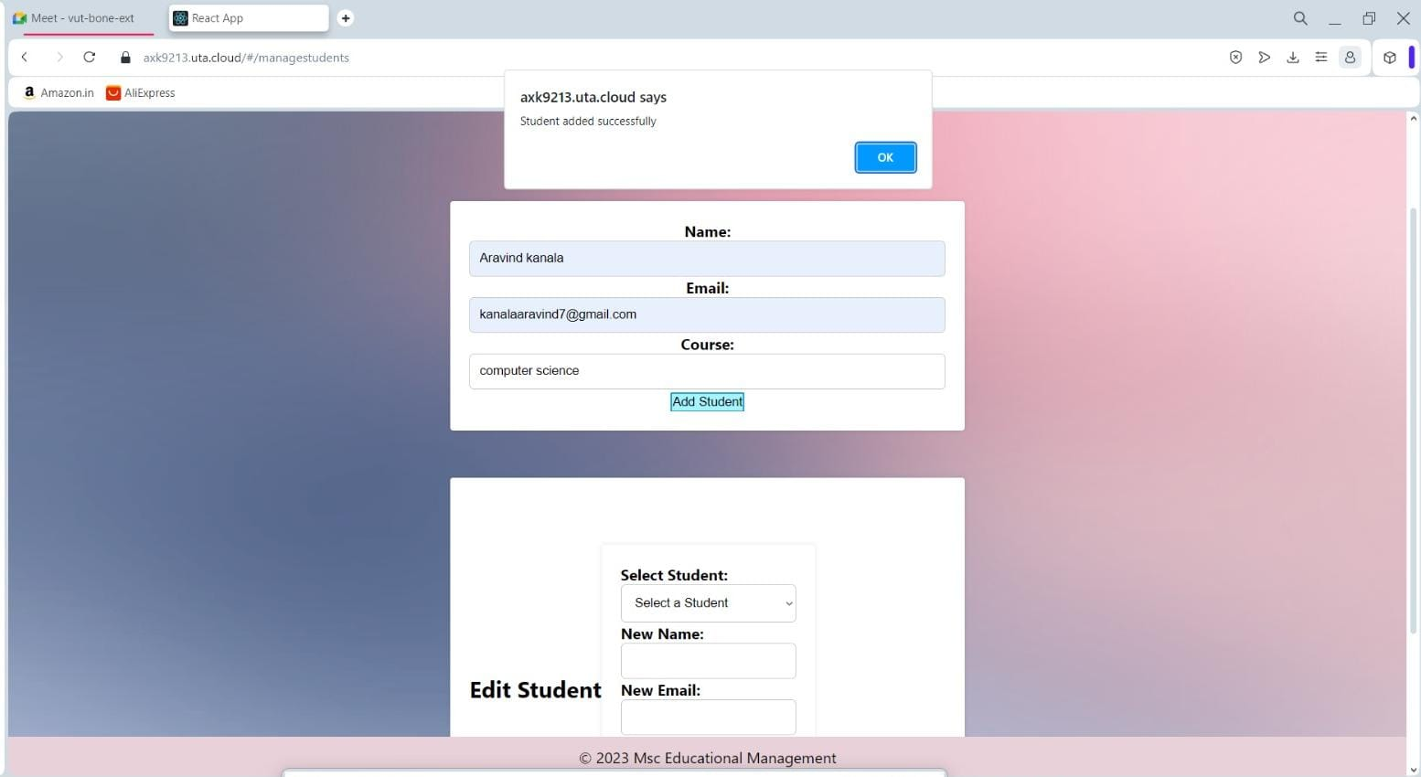
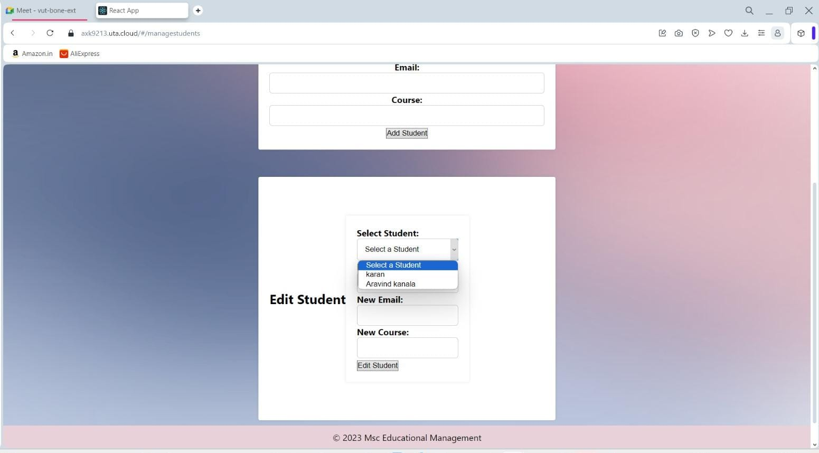
ADMIN DASHBOARD
Here, as you can see the Admin will be able to add a student
Similarly, he can also be able to edit any particular student's details

Slide 24
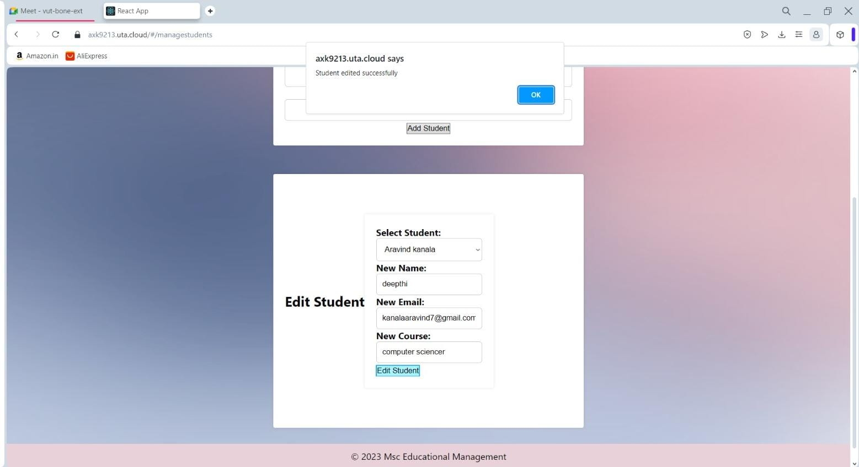
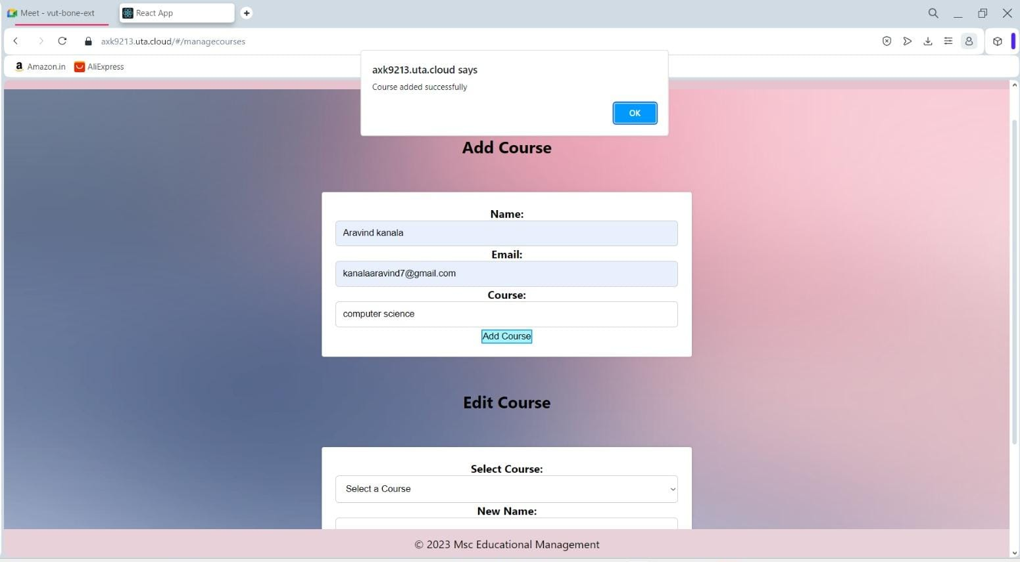
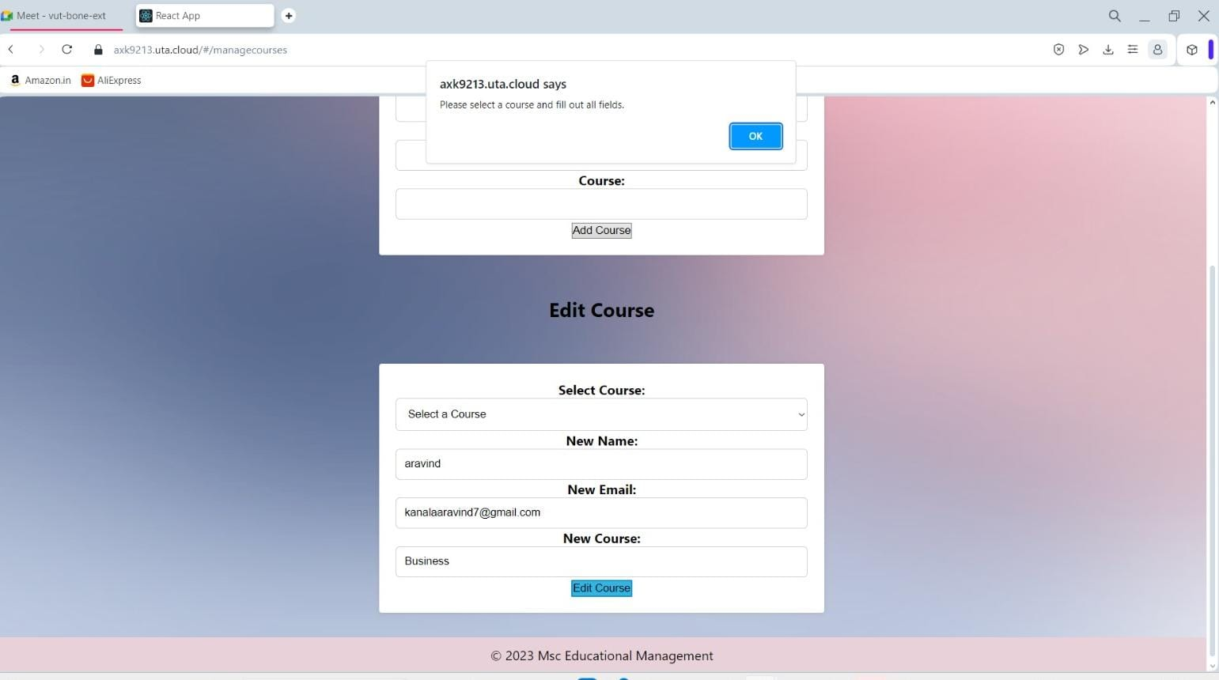
ADMIN DASHBOARD
Similarly, the admin can edit the student details add a course and edit that course

Slide 25
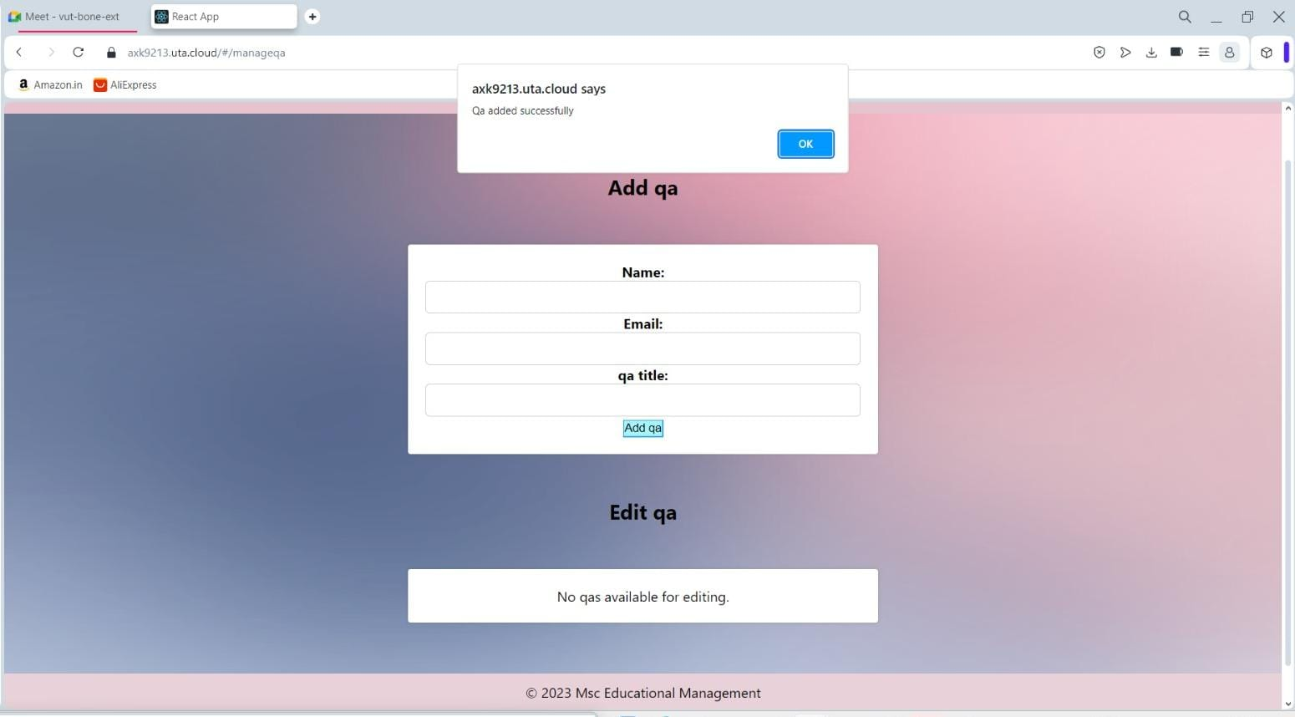
ADMIN DASHBOARD
Here, as you can see the Admin will be able to add a QA officer
Since we did not add any QAs it shows no one available for editing

Slide 26
QUALITY ASSURANCE OFFICER
DASHBOARD

Slide 27
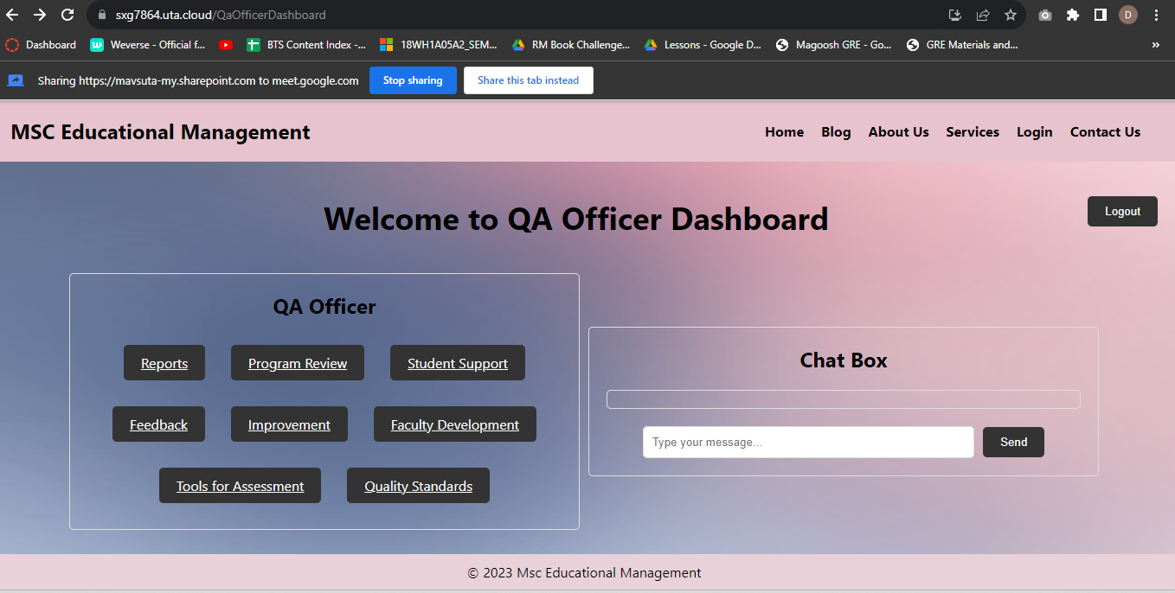
QUALITY ASSURANCE OFFICER
DASHBOARD

Slide 28
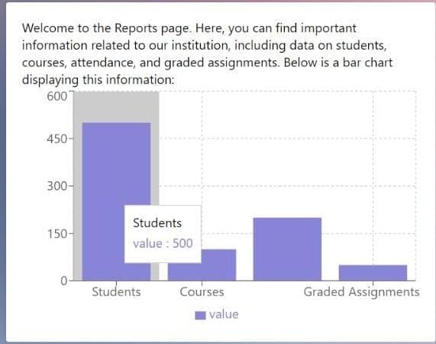
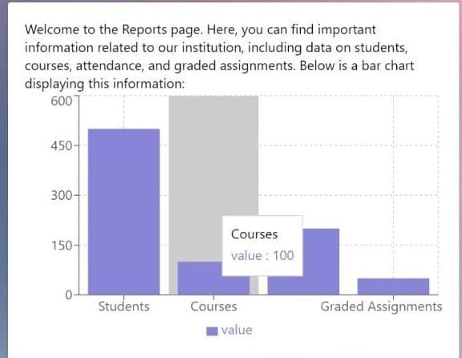
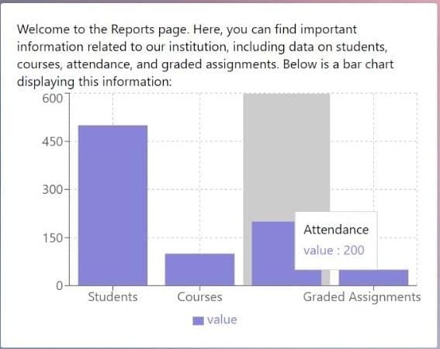
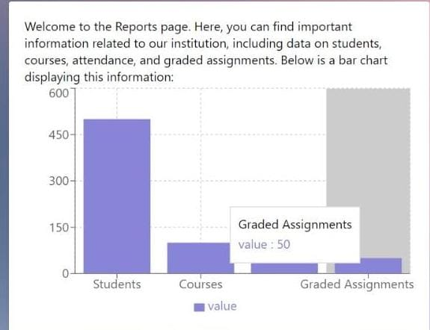
Reports

Slide 29
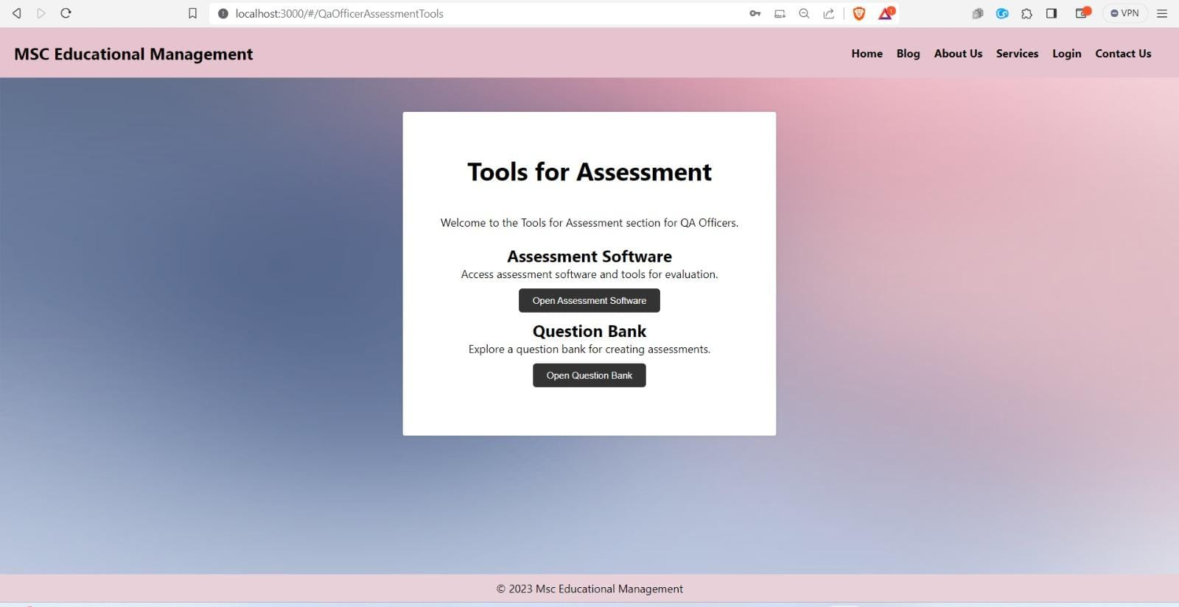

Slide 30
PROGRAM COORDINATOR DASHBOARD

Slide 31
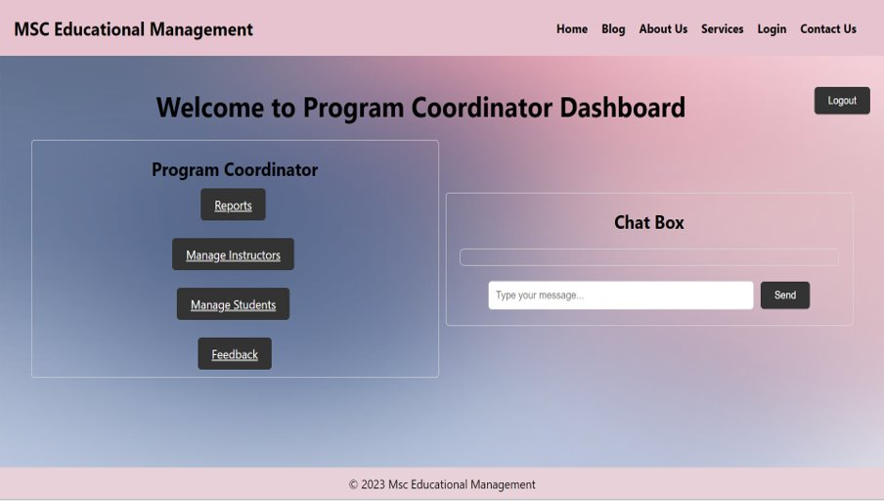

Slide 32
Program Coordinator Dashboard
Program Coordinators coordinates with instructors, administrators and others.
The webpage allows Program Coordinators to monitor student performance data implementation.
Program Coordinators provide guidance or support to instructors and students based on performance data.
Program Coordinators serve as a point of contact for students, addressing their concerns or inquiries related to the program.

Slide 33
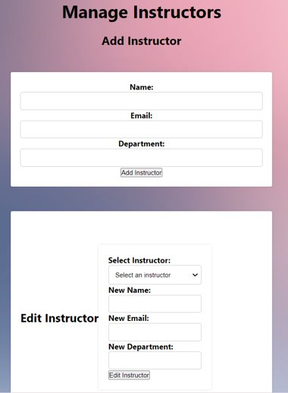
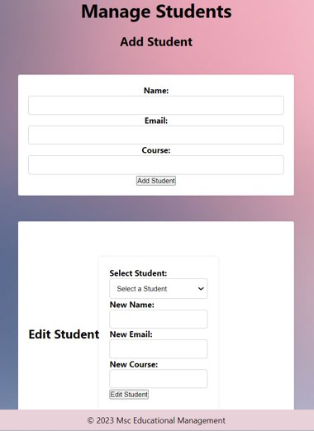

Slide 34
Instructor Dashboard

Slide 35
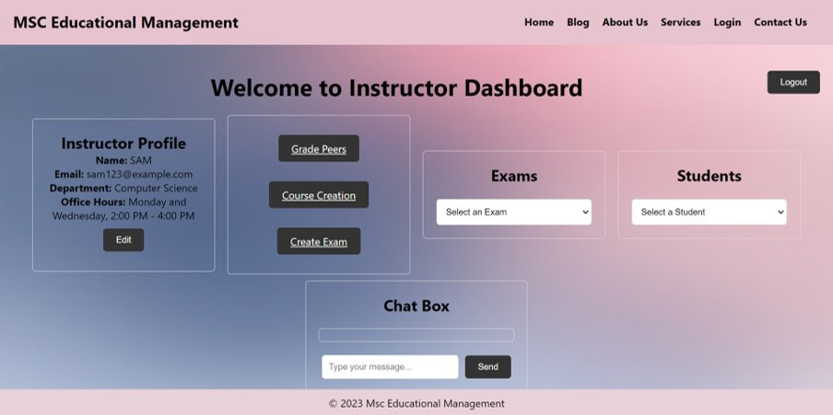

Slide 36
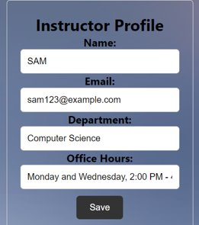
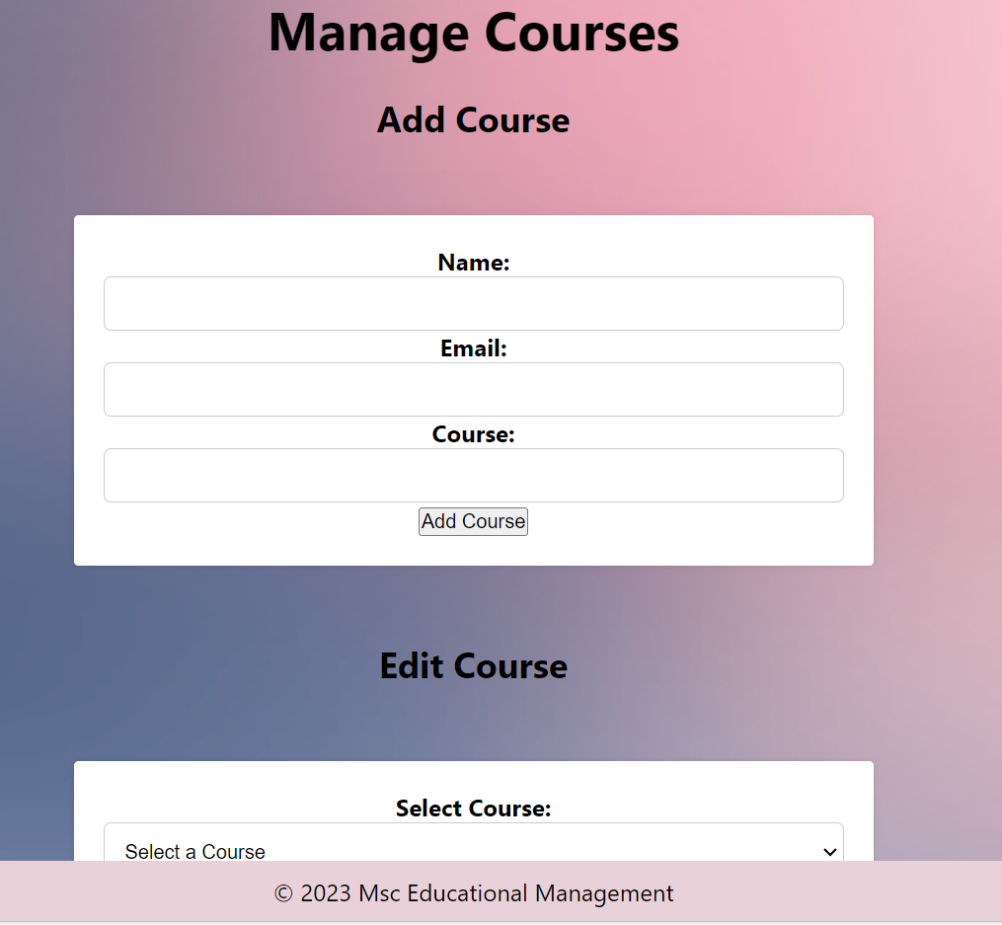
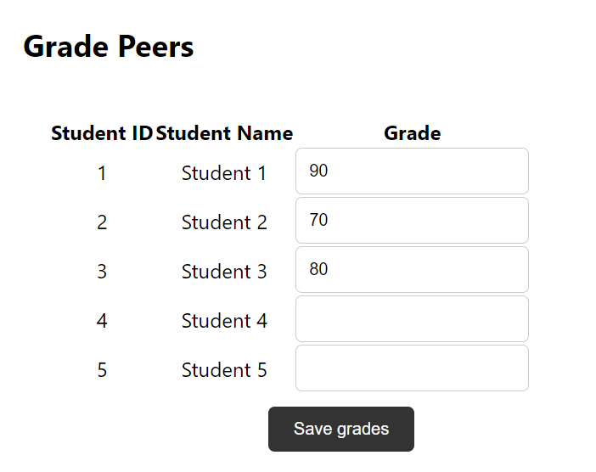
Instructor Operations
Instructor can edit profile
Grade Students and give feedback
Add and edit courses

Slide 37
Instructor
Personal information column of Instructor
Progress tracking of students.
Create exams
Instructors can create and manage courses.
Grade students and give Feedback to the students based on the assessments and exams.

Slide 38
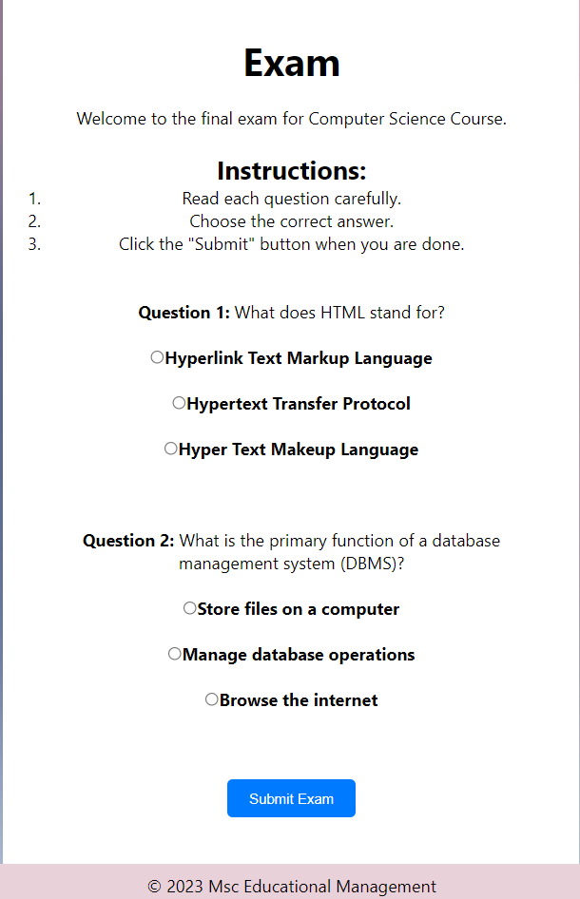
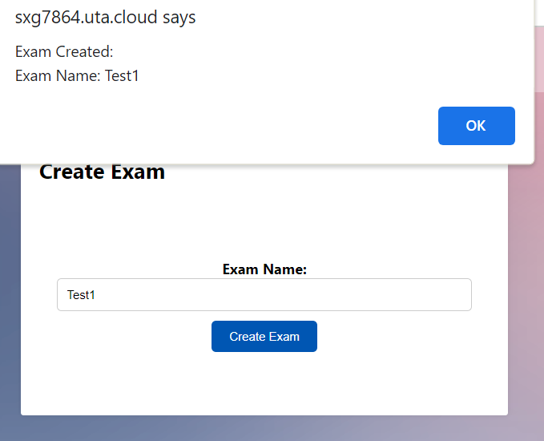
Instructor

Slide 39
CHALLENGES FACED
When it comes to cloud deployment, in early phases we struggled a bit to deploy but later we were able to deploy successfully.
Since Laravel is new concept for us, it took some good amount of time to learn it but eventually we were able to do it.

Slide 40
What did we learn?
This is one project which demonstrates our knowledge of HTML and CSS for structuring and styling web content.
It also showcases our proficiency in front-end development by using React for building dynamic user interfaces.
Highlights our ability to work on both the front-end and back-end by using technologies like Node.js for server-side scripting and Laravel for server-side application development.
Demonstrates our skills in implementing user authentication and authorization features, showcasing your understanding of secure login systems.
Showcase any new technologies, libraries, or frameworks you learned and implemented during the development process.
Highlight our knowledge of deploying web applications, including setting up servers, configuring environments, and managing hosting platforms.
Showcases a Complete Project
Having a fully functional web application in our portfolio/ Github allows potential employers or clients to see our ability to deliver complete and polished projects.

Slide 41
FUTURE SCOPE
Implementing Voice search enhancement using AI.
An Immersive reader to assist with reading and comprehension
Using emerging technologies such as blockchain for credential verification

Slide 42

Thank You

